Slide 1


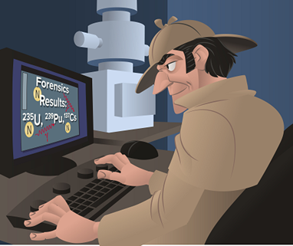

Nuclear Forensics Studies and the Development of a Companion Graduate Course
S. Landsberger and D. Haas
University of Texas at Austin, Nuclear Engineering Teaching Lab Austin, Texas, USA

Slide 2
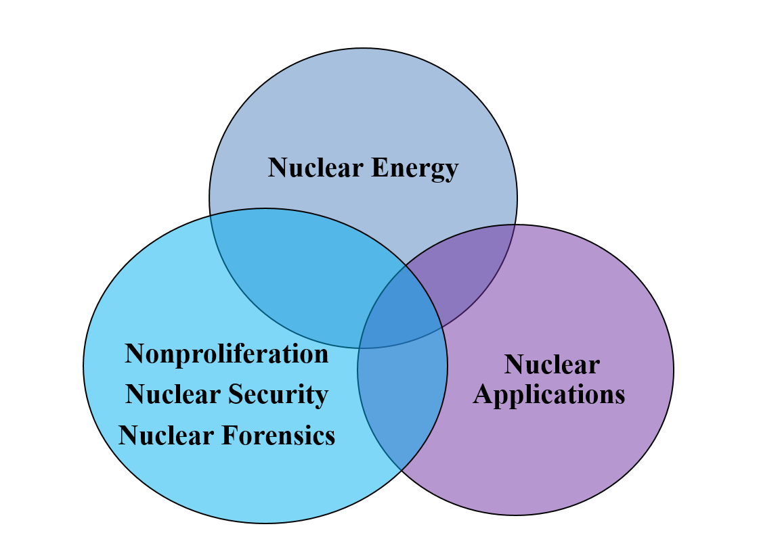
Facets of Nuclear Science and Engineering

Slide 3
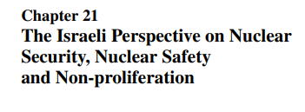
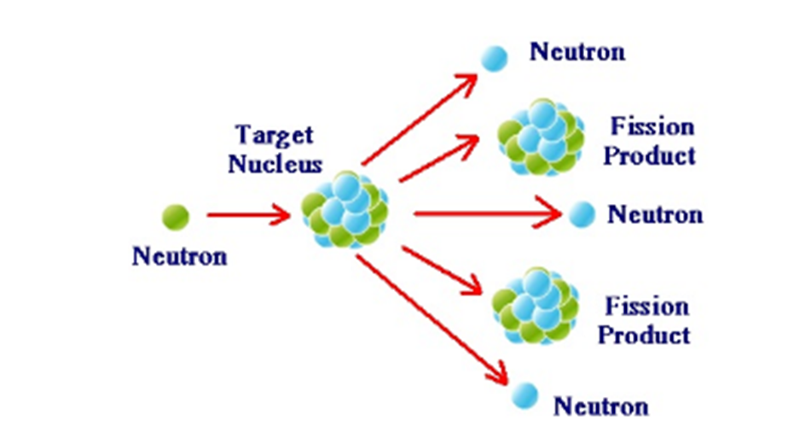
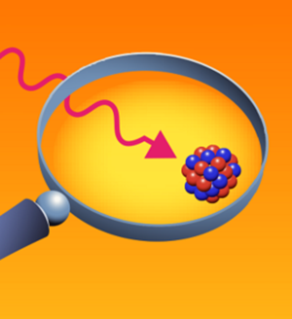
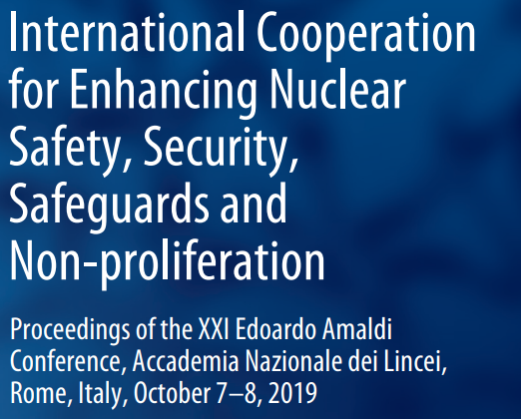
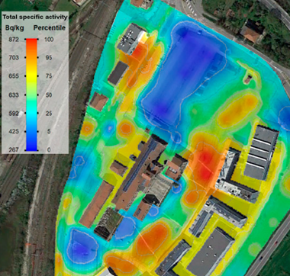
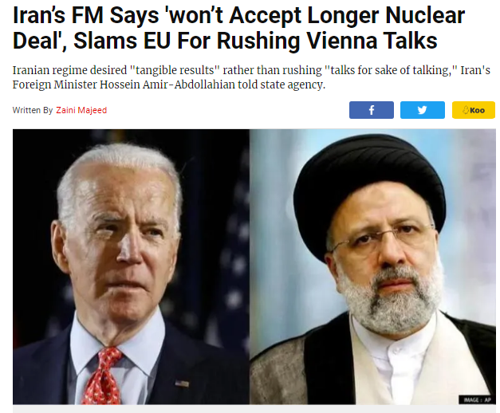
Nonproliferation
Nuclear Security
Nuclear Forensics
Nussbaum, Israel Atomic Energy Commission,
National and International Policy on Nuclear Matters
Potential Dirty Bomb Terrorism with Drones
Use of Drones to Detect Contaminated Sites

Slide 4
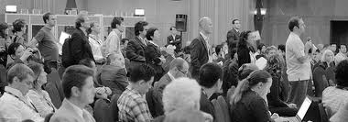

Introduction
In the 15th century the Latin term “forensis” came to being meaning to belong to the public forum.
Later the word forensics was incorporated into the English language to mean “pertaining to, connected with, or used in courts of law or public discussion and debate”.

Slide 5

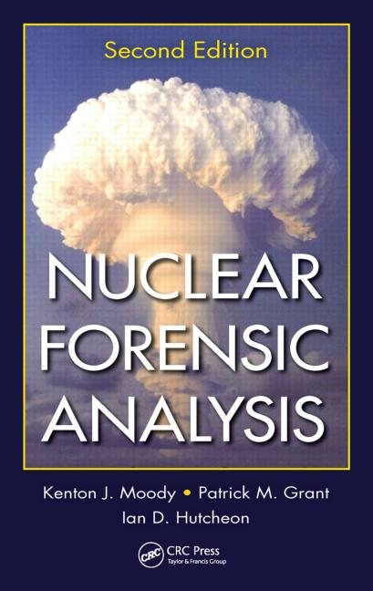
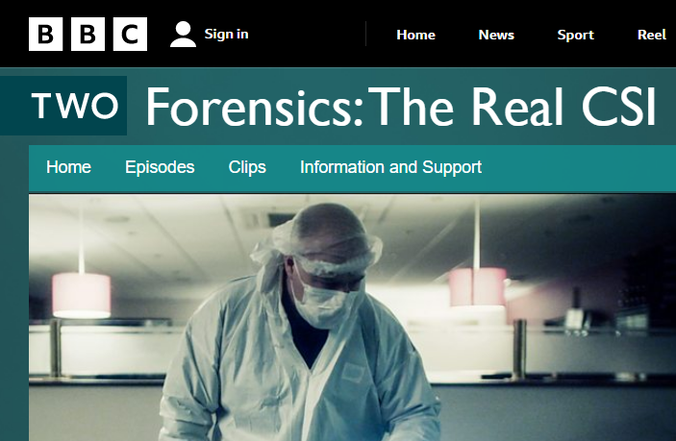
In recent years the word forensics has been popularized in the media and pop-culture in the many television shows and movies as part of crime scene investigations.
Today the term nuclear forensics is the detection and analysis of nuclear materials before they are used in a terrorist plot, the analysis of radioactive debris following a nuclear event or the investigation of the pedigree of nuclear materials in nonproliferation.

Slide 6
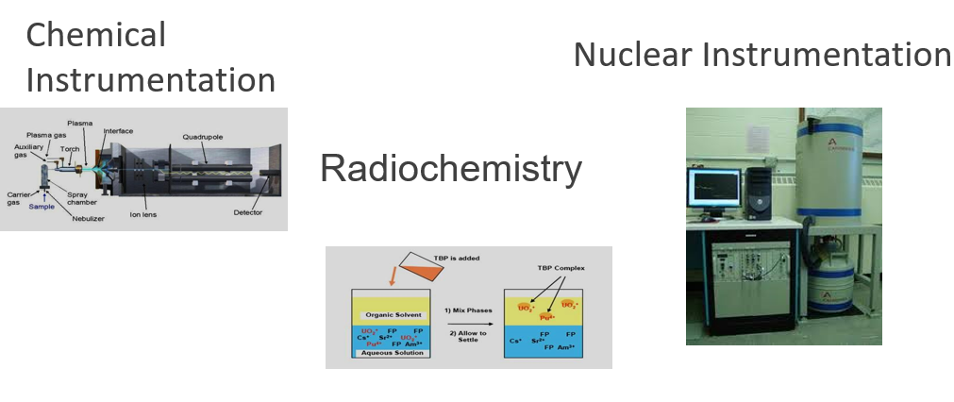
Types of Nuclear Forensics

Slide 7
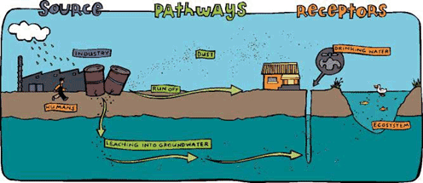
Radioecology
Chernobyl, Fukushima, NORM and TENORM

Slide 8
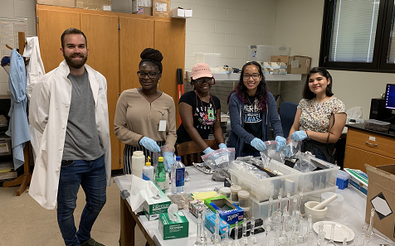
Nuclear Forensics at the University of Texas
Forefront of post detonation nuclear forensics research for many years as a result of very close collaborations with national labs.
The two consecutive 3-year Radiochemistry Education Award Program (REAP) from 2002-2005 and 2005-2008.
Nuclear Forensics Education Award Program (NFEAP): two consecutive three-year awards from 2009-2012, 2013-2016
Recently, awarded with a Department of Homeland Security grant in Nuclear Forensics in 2017-2022 which provides a pathway for PhD students with the opportunity to learn novel Nuclear Forensics techniques at the Air Force Technical Applications Center in Florida, including summer schools for HBCU/MSI

Slide 9
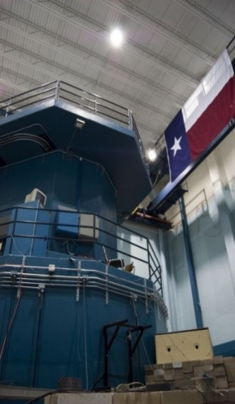
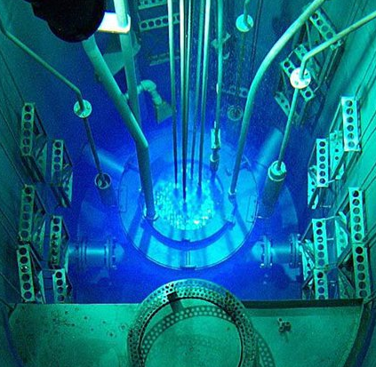
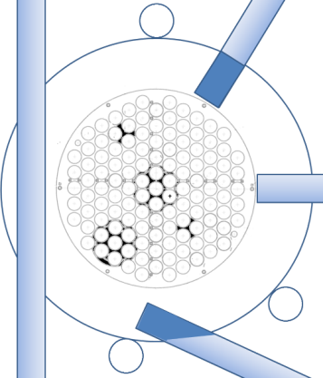
Facilities
Radiation Sources
1.1 MW TRIGA Nuclear Reactor
Thermo MP320 14-MeV Neutron Generator (1x10⁸ n/s with a Pulse Rate up to 20 kHz)
Neutron, α, β, and γ Radiation Sources
Beam Port Facilities
Neutron Radiography
Neutron Depth Profiling
Prompt-Gamma Activation Analysis
Fast Neutron Facility

Slide 10
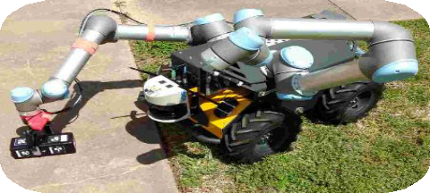
Analytical Laboratories
NAA Laboratory
Radiation Effects and Detector Development Laboratory
Gamma-Ray Spectroscopy Laboratory
Chemistry and Sample Preparation Laboratory
Radioactive Experiment and Radiochemistry Laboratory
Corrosion, Embrittlement, and Electrochemistry Lab

Slide 11
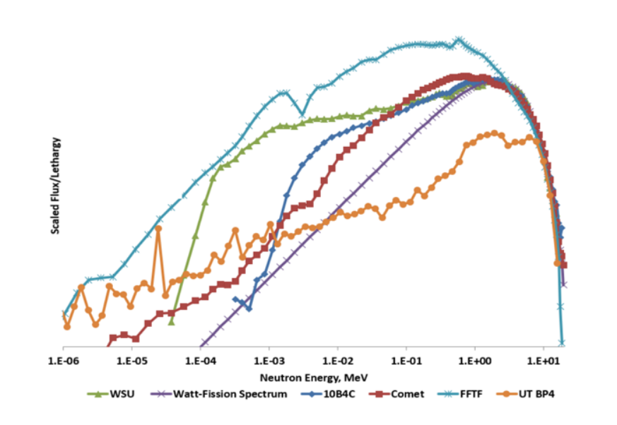
Detector Systems
Three Compton Suppression γ-Ray Spectroscopy Systems
β-γ and γ-γ Coincidence and α-Spectroscopy System
Numerous Portable Instruments
Nuclear and Applied Robotics
Develop and deploy advanced robotics in hazardous environments to minimize risk for the human operator
Fast Neutron Beam Irradiation Facility

Slide 12
Main Areas of Research
Low-level fission product Identification using Compton suppression and gamma-gamma coincidence Methods
Radioxenon subsurface transport
¹³⁷Cs measurements in soil
NAA of surrogates of ¹³⁷Cs and ⁹⁰Sr
Production of Xe-127 and Ar-37 isotopes
Cross-section measurements of Ar-37
Tackling uncertainties in short-lived radionuclide analysis for nuclear forensics

Slide 13
Preparation for large integrated field experiments with the design, assembly, and testing of field sampling equipment for particulate and gaseous tracers
Investigation of Chemical Speciation of Radionuclide Signatures Under Extreme Environmental Conditions
Development of Watertight Gamma-Gamma Coincidence Counter for Research Reactor Fuel Verification
Application of Neutron Safeguards Measurements to the Front-End of the Nuclear Fuel Cycle
Routine Isotopic and Radioactive Contamination Survey Platform in Dynamic Nuclear Environments

Slide 14
Lecture Objectives
At the end of the course students should be able to comprehend the concepts of nuclear forensics and understand the basics of radiation, radioactivity, and interactions of radiation with matter.
The students should be able to understand the fundamentals of gamma-ray spectroscopy, fission product identification, decay schemes, and counting statistics, Bateman equation, as well as the essentials of radiochemistry, separation science and the nuclear fuel cycles.

Slide 15
Experimental Objectives
half-life, secular equilibrium, counting statistics, gamma and beta shielding, gamma-ray spectroscopy including calibration, detector resolution, deadtime, gamma-ray self attenuation, fission product identification

Slide 16
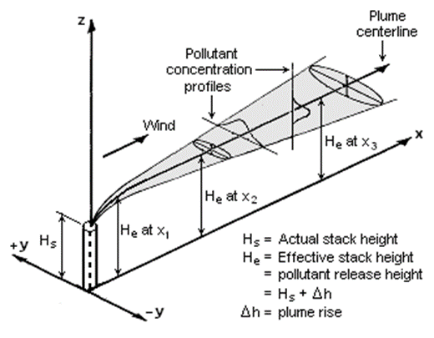
Atmospheric Dispersion and Radionuclide Releases

Slide 17
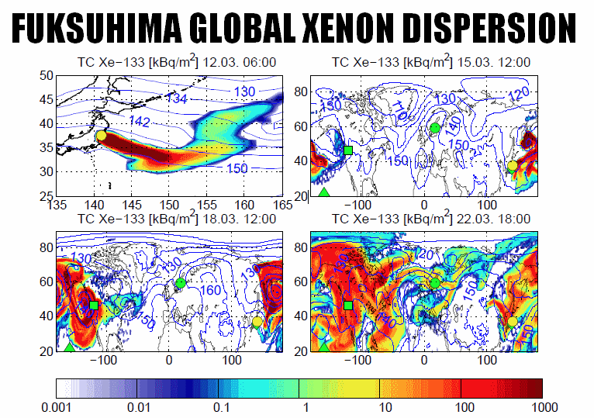
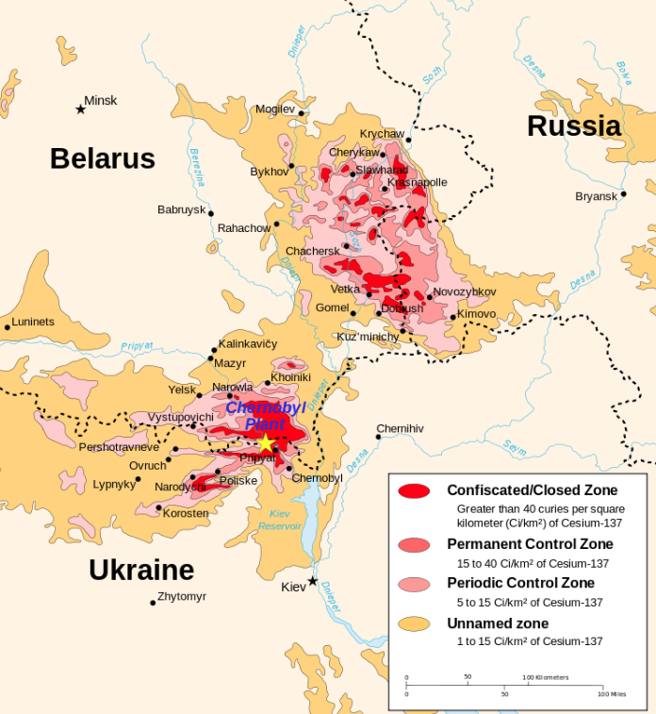
MODELS FOR DIFFERENT SCALES
atmospheric eddies causing turbulent diffusion have a wide spectrum spanning from near molecular scale to scales of several hundred kilometers
important features of the atmosphere must be considered in a dispersion model
http://alexanderhiggins.com/wp-content/uploads/2015/05/134.png
https://en.wikipedia.org/wiki/Chernobyl_disaster#/media/File:
Chernobyl_radiation_map_1996.svg

Slide 18
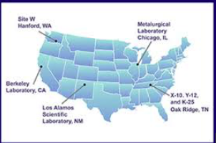
Manhattan Project Locations
Guest Lecturers
Making of the Atomic Bomb
Richard Brooks - Consultant
Hanford – water cooled reactor Pt-239 Built and Operated by Dupont Most successful option
Chicago – first sustaining reactor Built at University of Chicago Managed by Enrico Fermi
Berkley – Calutrons
Separate U-235 from U-238
0.002%
Oak Ridge – X-10 Pt-240 K-25 – Uranium Enrichment, diffusion
Y-12 – Uranium Enrichment, Calutron
Run by the Eastman Chemical Co.
Los Alamos – Bomb Design Bomb Production

Slide 19


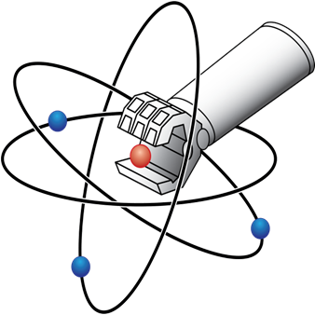
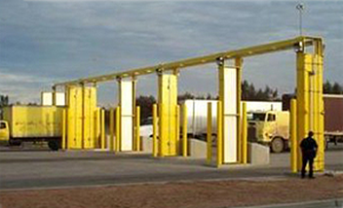
Pop Culture Goes Nuclear – Mihir Pai (Graduate Student, University of Texas)
Locating Radioactive Sources with a Robot (Dr. Anderson (University of Texas)
Radiation Portal Monitors (Dr. Charlton, University of Texas)
Duck and Cover

Slide 20
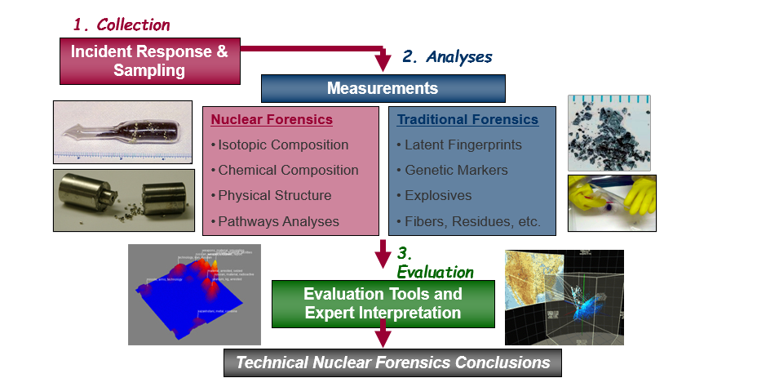
Nuclear Forensics and Attribution W. Charlton – University of Texas
General Pre-Det Materials Nuclear Forensics Process

Slide 21
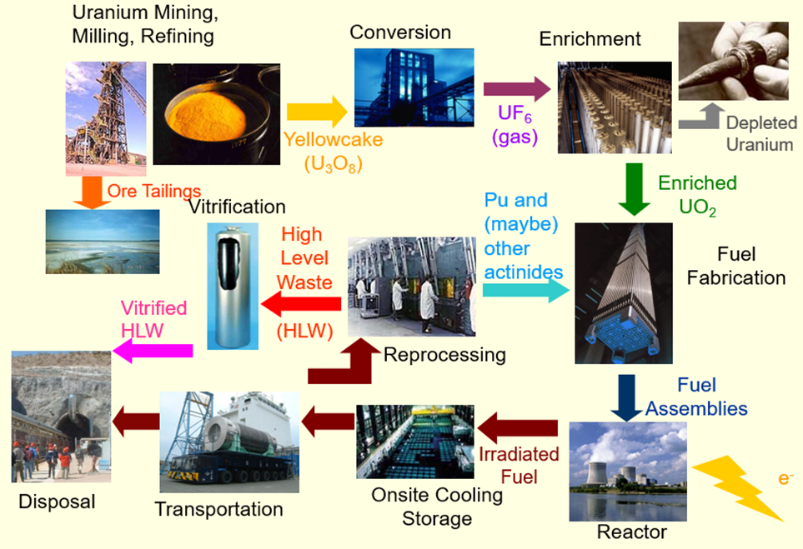
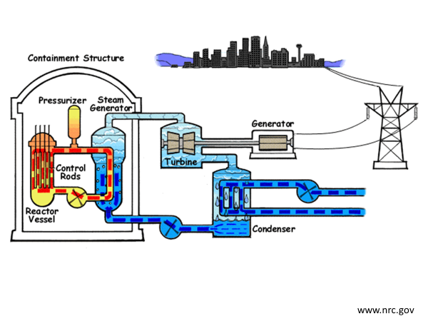
Nuclear and Radiochemistry: Chemical Equilibrium, Chemical Separations, Chemistry of the Actinides and Fission Products, Nuclear Fuel Cycle, Nuclear Fuel Reprocessing (Dr. Lapka, University of Texas)
How Nukes Work (Dr. Haas, University of Texas)

Slide 22
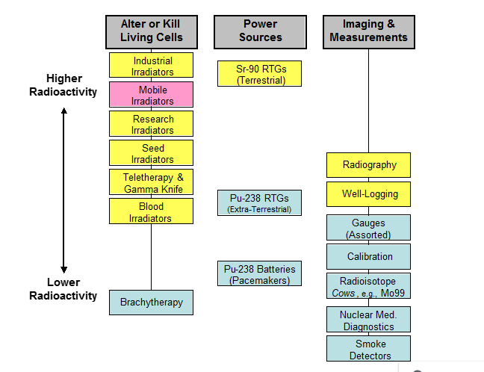
History and Radiation Effects of Radiological Weapons W. Charlton – University of Texas

Slide 23


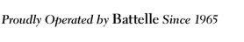




Cat Litter, Nitric Acid, Plutonium, and $2.4 Billion:
PNNL’s role in the investigation into the 2014 Contamination at the Waste Isolation Pilot Plant
J. Schwantes
PNNL-SA-121331

Slide 24
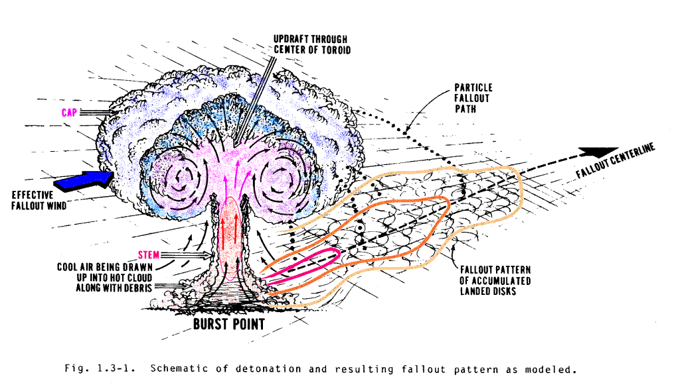
Post-detonation forensic analysis of nuclear fallout using on-site gamma spectroscopy
John Mattingly
North Carolina State University
A near-surface nuclear explosion lofts and vaporizes tons of soil
Notes:
Ground burst lofts about 300 tons of soil per kiloton of explosive yield

Slide 25
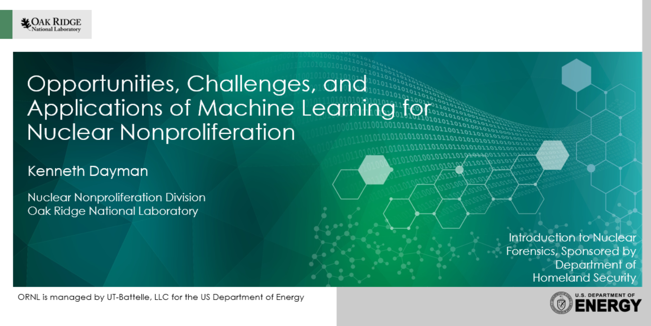

Slide 26
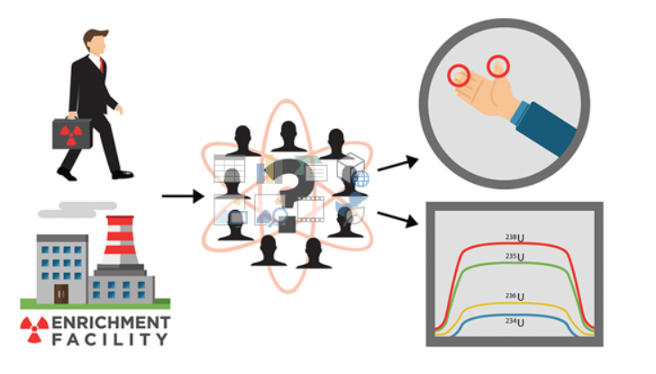
Monitoring Occupational Exposure to Special Nuclear Materials
Use of Hair and Nail as a non-invasive, integrative monitor of U and Pu for nuclear forensic analyses
John Brockman
University of Missouri at Columbia

Slide 27
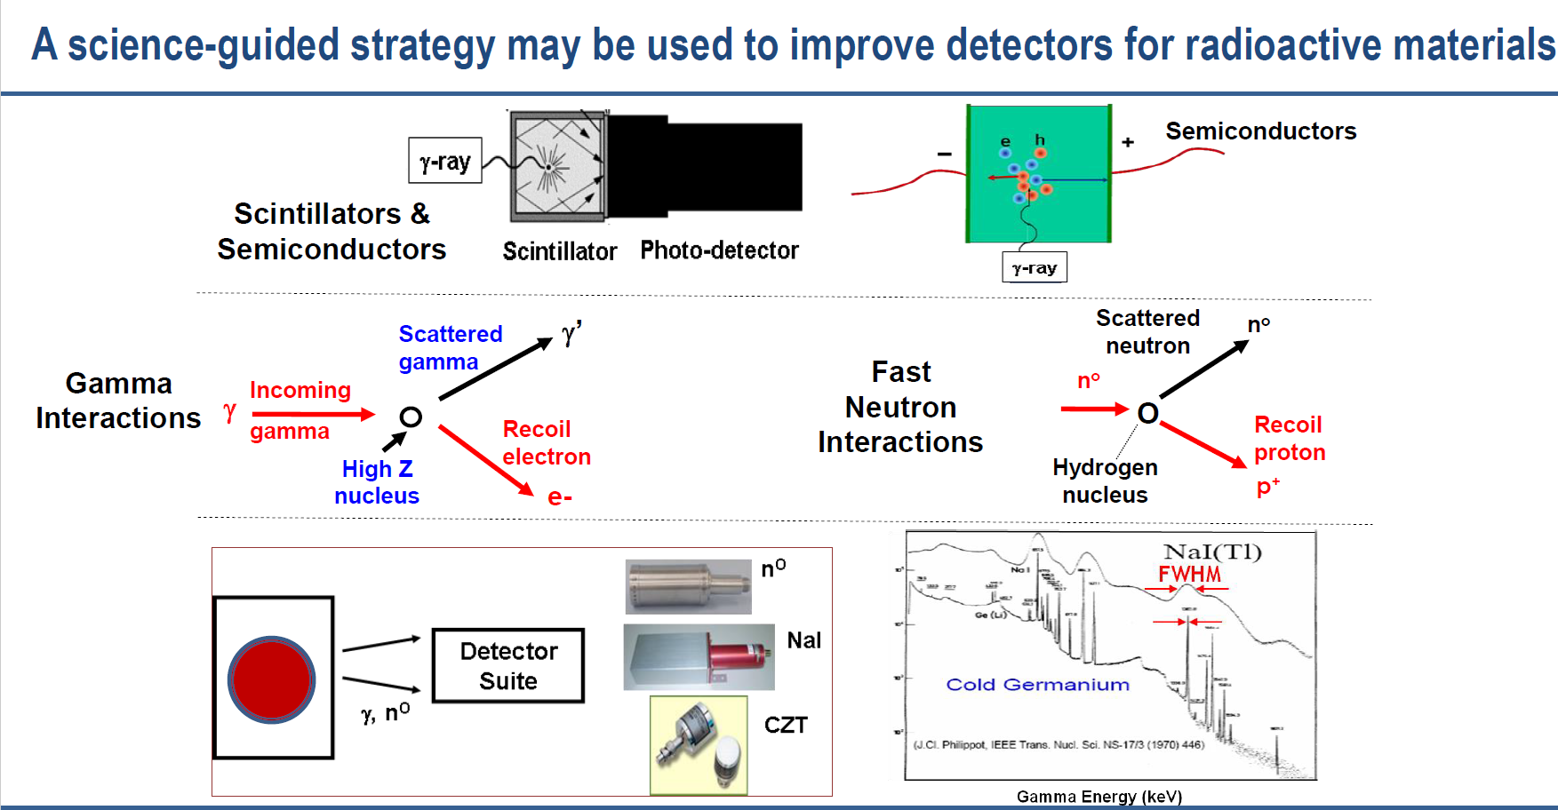
New Scintillators and their Integration into Detector Systems N. Cherepy Lawrence Livermore National Laboratory

Slide 28
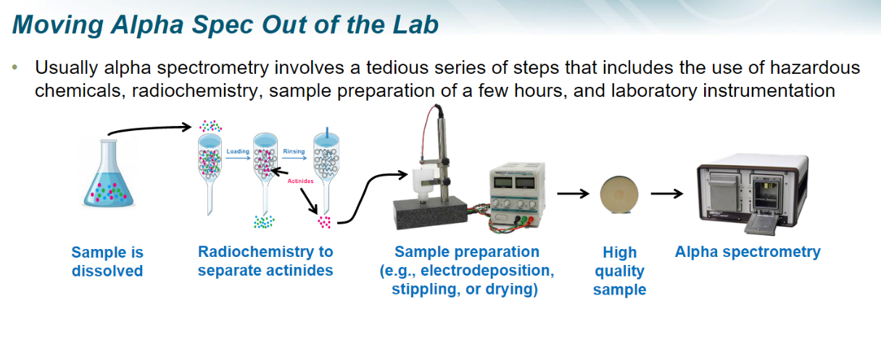
Development of Fieldable Alpha Spectrometry Systems for Nonproliferation and Nuclear Forensics
Dr. Chichester, Idaho National Laboratory

Slide 29
Solid Phase Fuel Cycle Chemistry
(Dr. Spano, ORNL)
Passive and Active Neutron NDA Techniques
(Dr. C. Thompson, LANL)
Materials Role Analysis for Nuclear Forensics
(Dr. Kapsimalis, ORNL)

Slide 30
Take Home Exam
In 1992 an El-Al Cargo 747 Airplane travelling from JFK in New York to Ben Gurion Airport 150 kg of depleted uranium was used as a balance weight for the aircraft.
Give a complete historical description/assessment of the treaties between the former USSR and the USA in limiting the production of nuclear weapons.
Give a complete historical description/assessment of the history of the North Korean, Pakistan, and Indian nuclear weapons program.
Give a complete historical description/assessment of the history of the Iranian nuclear weapons program.
Since 1963 the nuclear powers agreed to a partial test-ban treaty so that atmospheric tests were prohibited and limited to underground testing.
Give a complete historical description/assessment of the history of the Indian and Pakistani nuclear weapons programs.
²¹⁰Po and Yasser Arafat

Slide 31
Conclusions
Very good student satisfaction
Major challenges for on-line laboratory development
Challenges of organization of time slots for invited lecturers outside the University of Texas
Zoom recordings of lectures and laboratories archived for future use
Acknowledgments: We are grateful for the financial support of the US Department of Homeland Security

